Slide 1
Using the Body to
Regulate Emotion:
Perspectives from DBT
Suzette Bray, LMFT
@villagewellness
/villagewellness.solutions

Slide 3
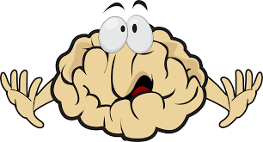
@villagewellness
/villagewellness.solutions

Slide 4
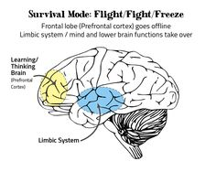
@villagewellness
/villagewellness.solutions

Slide 5
Physiological Experiences Associated with Fear
Breathlessness
Rapid heartbeat
Muscle tension
Nausea, “butterflies”
Feeling cold or clammy
Shaking
Perspiring
Feeling of hairs standing on end
@villagewellness
/villagewellness.solutions

Slide 6
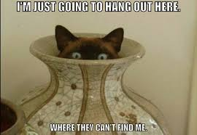
@villagewellness
/villagewellness.solutions

Slide 7
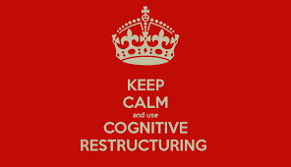
@villagewellness
/villagewellness.solutions
Notes:
All nice people who want me to succeed, underwear

Slide 8
@villagewellness
/villagewellness.solutions
Notes:
I just talked about underpants in front of a whole bunch of people i want to respect

Slide 9
Physiological Experiences Associated with Shame
Pain in pit of stomach or chest
Sense of dread
Wanting to shrink down and/or disappear
Wanting to hide or cover your face and body
Looking down and away from others
@villagewellness
/villagewellness.solutions

Slide 10
@villagewellness
/villagewellness.solutions

Slide 11
Validation
To acknowledge and accept a person’s feelings, thoughts, and internal experience as valid and understandable.
@villagewellness
/villagewellness.solutions

Slide 12
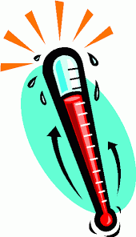
Subjective Units of Distress (SUDs)
A scale of 0 to 100 for measuring the subjective intensity of disturbance or distress currently experienced by an individual.
@villagewellness
/villagewellness.solutions

Slide 13
The Bio in the Bio-Social Theory
or
Why fabulous interventions don’t work sometimes for some people.
Some people are born with a biological vulnerability to emotions:
High sensitivity to emotions
High reactivity to emotions
Slow return to baseline
Difficulty successfully regulating emotions
@villagewellness
/villagewellness.solutions

Slide 14
@villagewellness
/villagewellness.solutions

Slide 15
Categories of body-based skills to regulate emotions:
“DBT Style”
Slow and Steady
Picking up Speed...
TURBOCHARGED!
@villagewellness
/villagewellness.solutions

Slide 16
SLOW AND STEADY
Slower Acting Skills (but still super good!)
Reduce vulnerability to emotion mind with PLEASE Skills
PL- treat PhysicaL illness
E- balance Eating
A- avoid mood-Altering substances
S- balance Sleep
E- get Exercise
@villagewellness
/villagewellness.solutions

Slide 17
PICKING UP SPEED
These are faster, but still “gentle” skills
Changing posture or facial expression
Willing hands
Half-smile
Soothing the body
Soothing with touch
Distracting the body
Using the vestibular system
@villagewellness
/villagewellness.solutions

Slide 18
TURBOCHARGED!(vroom vroom!)
Fast-Acting and Effective
(sounds like a drug ad)
TIP(P) SKILLS
Temperature
Intense Exercise
Paced Breathing
Paired Muscle Relaxation
@villagewellness
/villagewellness.solutions

Slide 19
Paired Muscle Relaxation
(Takes practice, but worth it!)
While deeply breathing, tense body muscles
Notice tension
Breathe out, saying “Relax”
Let go of tension
Notice the difference in your body
*Want to be super fancy? Try Effective Rethinking and Paired Relaxation!
@villagewellness
/villagewellness.solutions
Notes:
Start with 16 muscle groups, takes 5-10 x a day for 5 to 6 weeks to get good

Slide 20
Paced Breathing
Breathe deeply into your belly
Slow pace of inhaling and exhaling way down
Five to six breaths per minute is the goal
“In” breath should be shorter than “out” breath
(for example, 5 seconds in, 7 seconds out)
There’s an app for that. Lots of them.
*Watch for relaxation-induced panic. Yes, it’s a thing. Really.
@villagewellness
/villagewellness.solutions
Notes:
Bubbles, activate parasympathetic nervous system, no bubble-related trauma

Slide 21
Intense Exercise
Engage in intense aerobic exercise for at least 20 minutes
Re-regulates body to less emotional state
State anxiety decreases with heart rate at 70% of maximum for age
Increases in positive emotions associated with heart rate 55-70% but effects are longer lasting at 70%
Effective in reducing anger, agitation, rumination
@villagewellness
/villagewellness.solutions
Notes:
Bubbles, activate parasympathetic nervous system, no bubble-related trauma

Slide 22
And, now!
My favorite DBT Skill!!!
But first, a word from our attorneys:
Individuals with heart disorders, heart rate below normal baseline due to medications, other medical problems, anorexia nervosa, bulimia nervosa, or allergy to cold should only use this procedure with the permission of their medical providers.
@villagewellness
/villagewellness.solutions

Slide 23
Temperature
(Cold works wonders!)
Immerse face in cold water (not below 50 degrees)
Or, place a zip-lock bag of cold water and ice or cold-pack across eyes and upper cheeks
Hold your breath (tells your brain you are diving underwater)
“Dive response” will occur in about 15 to 30 seconds
Heart will slow down, blood flow to nonessential organs is reduced, blood flow redirected to brain and heart.
Lasts about 5 to 20 minutes, have another skill ready
@villagewellness
/villagewellness.solutions

Slide 25
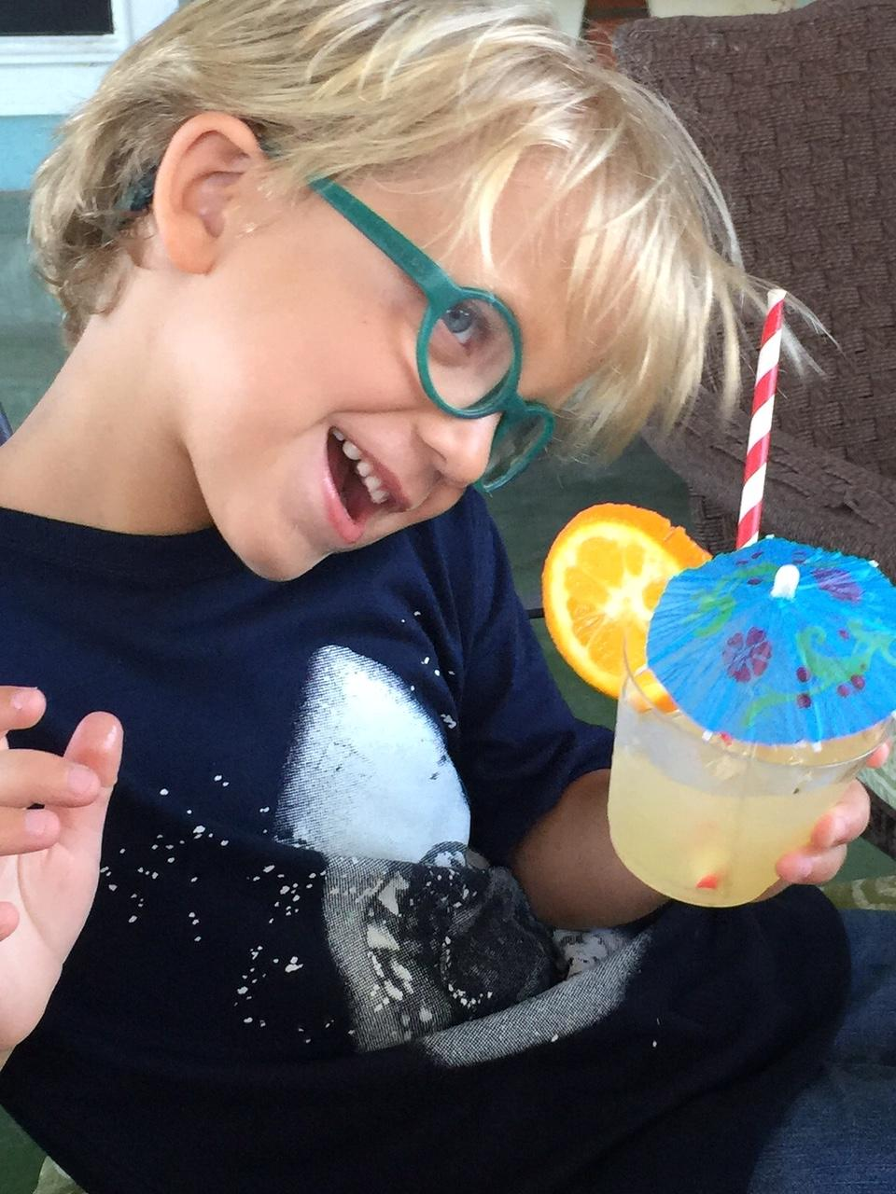
Thanks for coming!
818 238 9895
www.villagecounselingandwellness.com
@villagewellness
/villagewellness.solutions

